Slide 1
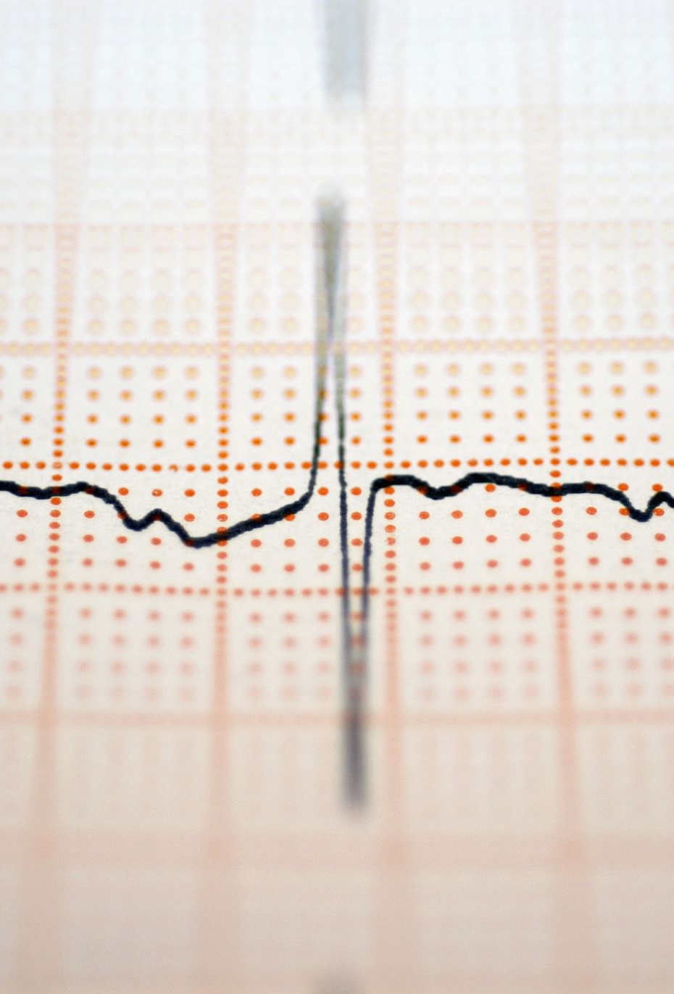
CAPSTONE PROJECT 3 Cardiovascular Risk Prediction
TEAM MEMBERS
AMITHA K
APOORVA VISHWAKARMA
ABHISHEK P SADAWARTE
MOHD KHALID
SHASHANK KUMAR YADAV

Slide 2
CONTENT
INTRODUCTION
PROBLEM STATEMENT
DATA SUMMARY
METHODOLOGY
EXPLORATORY DATA ANALYSIS
FEATURE ENGINEERING
BUILDING MODEL
EVALUATION METRIC
PRECISION AND RECALL
CHALLENGES FACED
CONCLUSION
Q AND A

Slide 3

INTRODUCTION
Cardiovascular disease (CVD) is a general term for conditions affecting the heart or blood vessels.
It's usually associated with a build-up of fatty deposits inside the arteries (atherosclerosis) and an increased risk of blood clots.
It can also be associated with damage to arteries in organs such as the brain, heart, kidneys and eyes.

Slide 4
INTRODUCTION
What are the main causes of coronary heart disease?
Smoking. Smoking is a major risk factor for coronary heart disease.
High blood pressure. High blood pressure (hypertension) puts a strain on your heart and can lead to CHD.
High cholesterol.
High lipoprotein (a)
Lack of regular exercise.
Diabetes.
Machine Learning is one of the slanting innovations utilized in numerous circles far and wide including the medicinal services application for predicting illnesses.
In this project, data of Framingham city is given.
The Framingham Heart Study is a long-term, ongoing cardiovascular cohort study of residents of the city of Framingham, Massachusetts.

Slide 5

PROBLEM STATEMENT
The dataset is from an ongoing cardiovascular study on residents of the town of Framingham, Massachusetts. The classification goal is to predict whether the patient has a 10-year risk of future coronary heart disease (CHD). The dataset provides the patients’ information. It includes over 4,000 records and 15 attributes. Variables Each attribute is a potential risk factor. There are both demographic, behavioral, and medical risk factors.

Slide 6
DATA SUMMARY
Demographic:
• Sex: male or female("M" or "F")
• Age: Age of the patient;(Continuous - Although the recorded ages have been truncated to whole numbers, the concept of age is continuous) Behavioral
• is_smoking: whether or not the patient is a current smoker ("YES" or "NO")
• Cigs Per Day: the number of cigarettes that the person smoked on average in one day.(can be considered continuous as one can have any number of cigarettes, even half a cigarette.) Medical( history)
• BP Meds: whether or not the patient was on blood pressure medication (Nominal)
• Prevalent Stroke: whether or not the patient had previously had a stroke (Nominal)
• Prevalent Hyp: whether or not the patient was hypertensive (Nominal)
• Diabetes: whether or not the patient had diabetes (Nominal)

Slide 7
DATA SUMMARY
Medical(current)
• Tot Chol: total cholesterol level (Continuous)
• Sys BP: systolic blood pressure (Continuous)
• Dia BP: diastolic blood pressure (Continuous)
• BMI: Body Mass Index (Continuous)
• Heart Rate: heart rate (Continuous - In medical research, variables such as heart rate though in fact discrete, yet are considered continuous because of large number of possible values.)
• Glucose: glucose level (Continuous) Predict variable (desired target)
• 10-year risk of coronary heart disease CHD(binary: “1”, means “Yes”, “0” means “No”) - DV

Slide 8
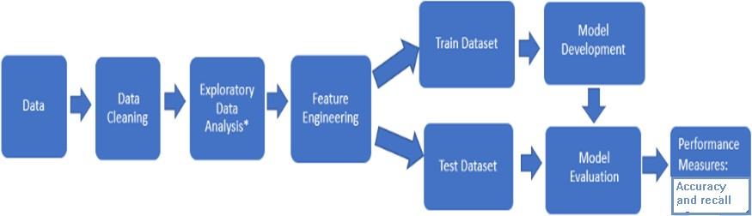
Methodology

Slide 9

EXPLORATORY DATA ANALYSIS
Exploratory Data Analysis refers to the critical process of performing initial investigations on data so as to discover patterns, to spot anomalies, to test hypothesis and to check assumptions with the help of summary statistics and graphical representations.

Slide 10
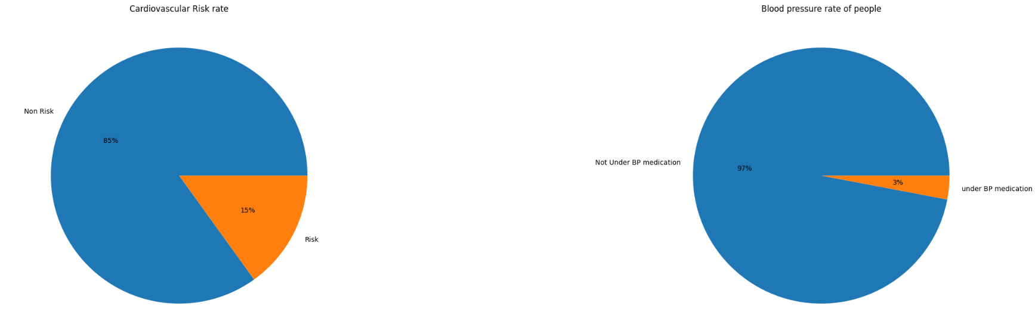

Slide 11
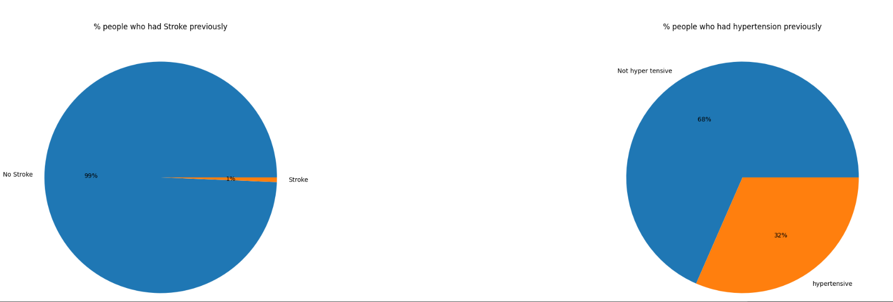

Slide 12
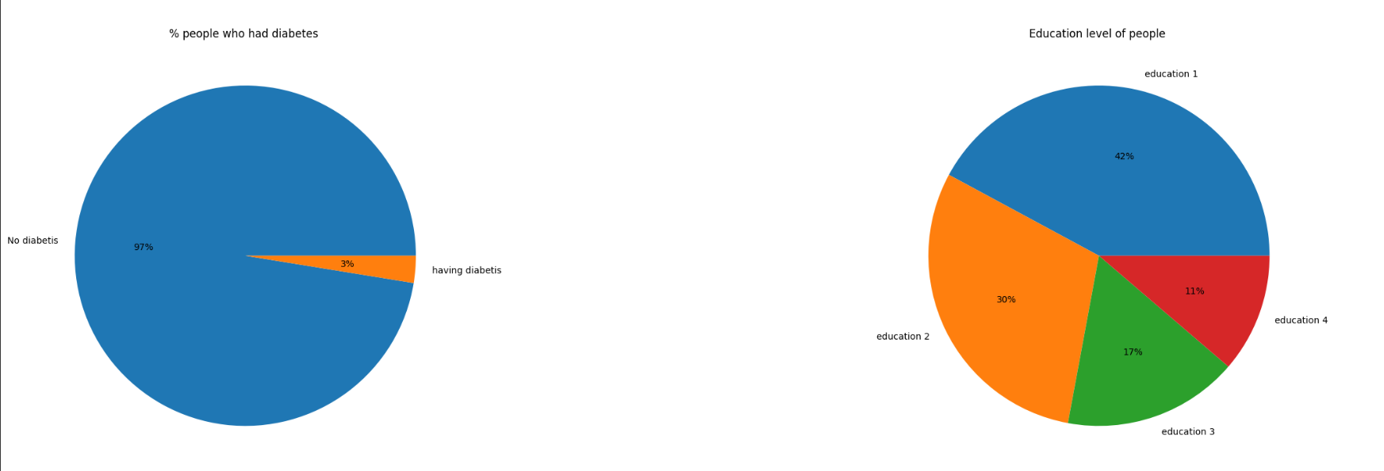

Slide 13
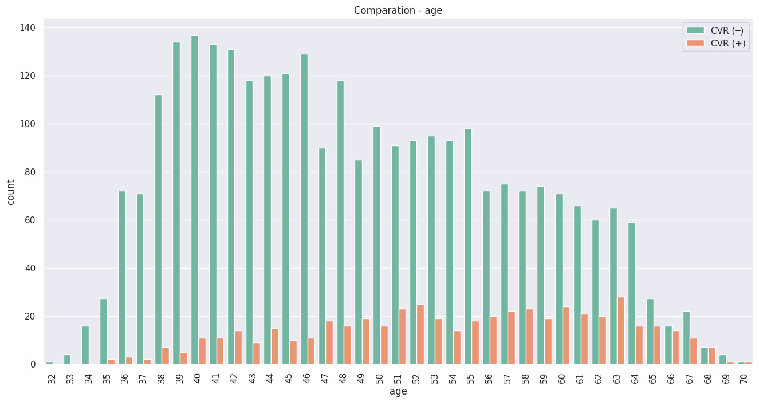

Slide 14
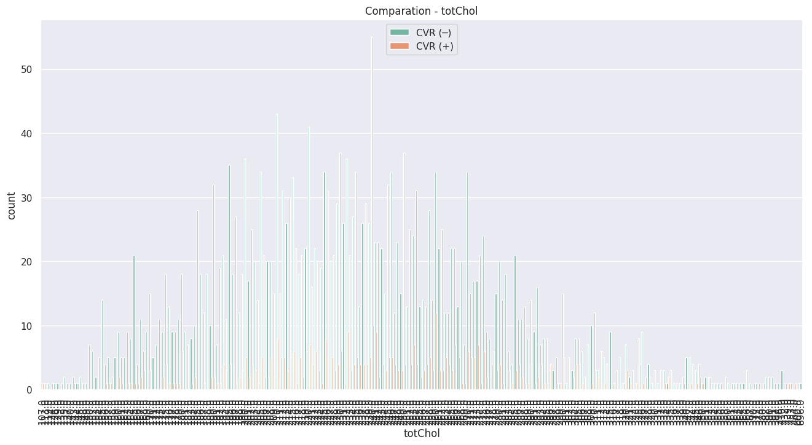

Slide 15
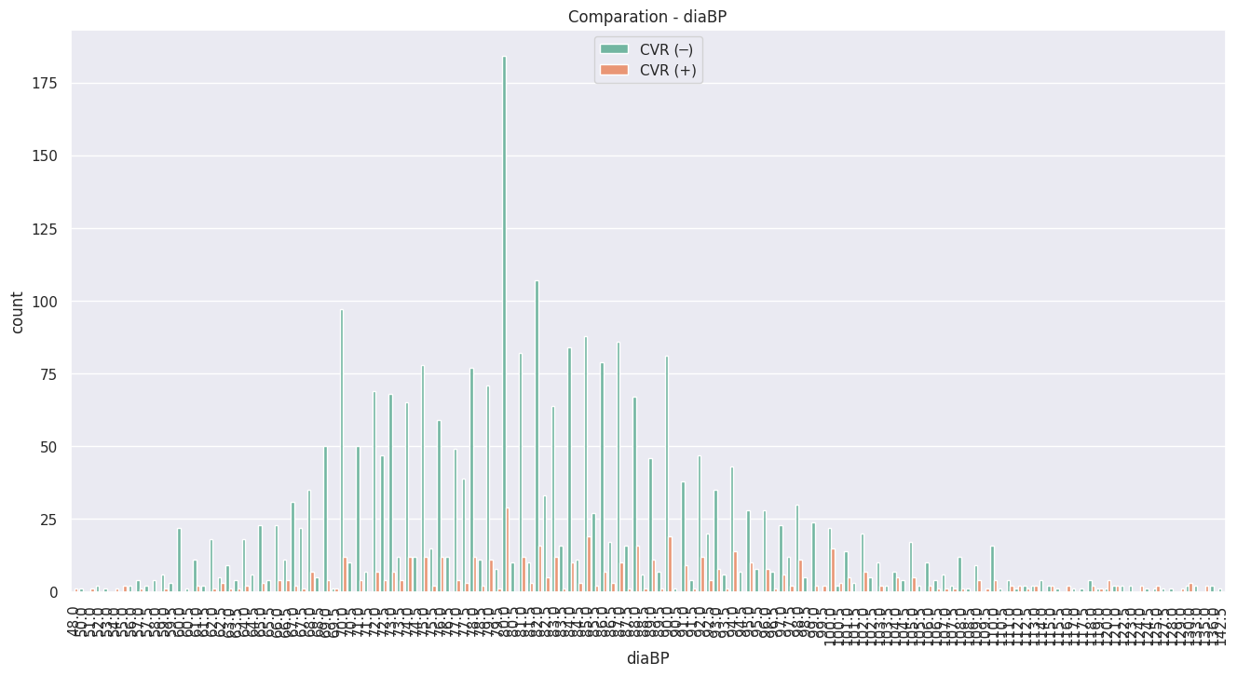

Slide 16
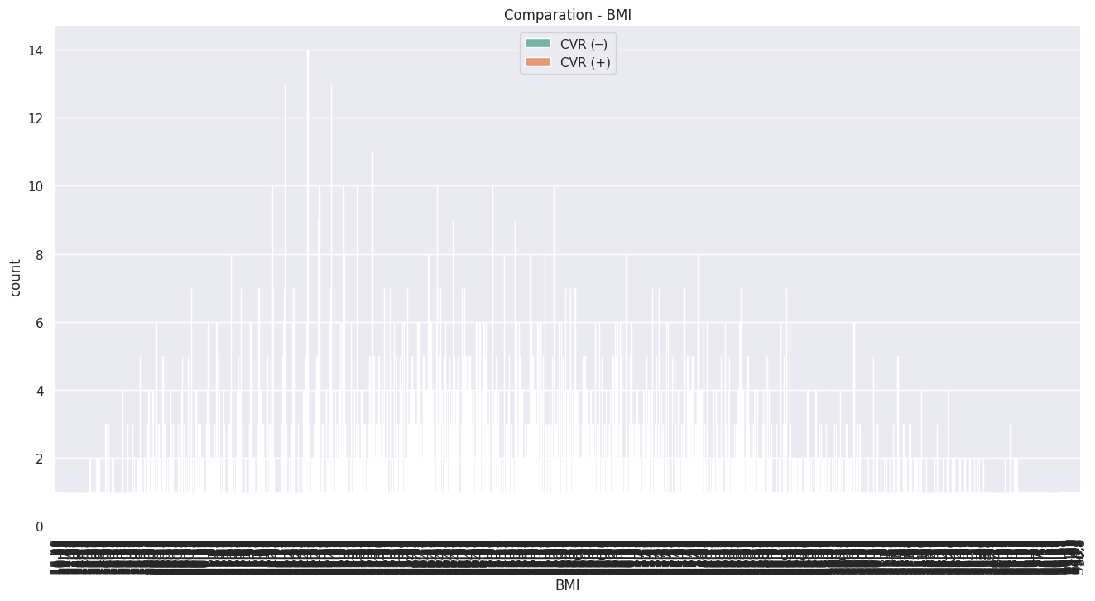

Slide 17
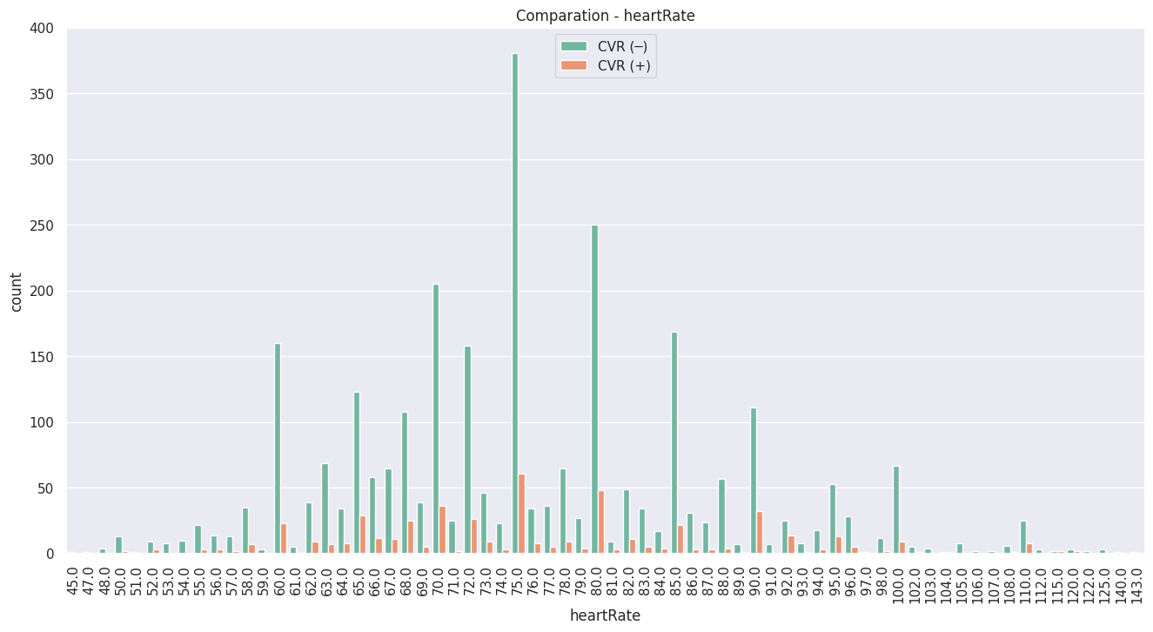

Slide 18
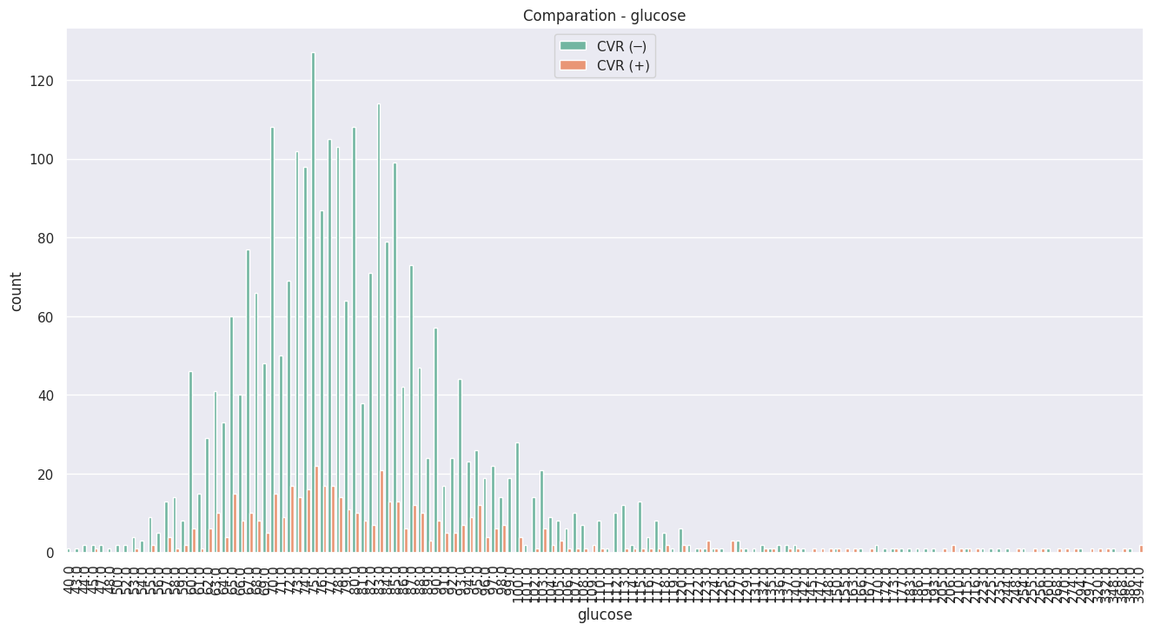

Slide 19
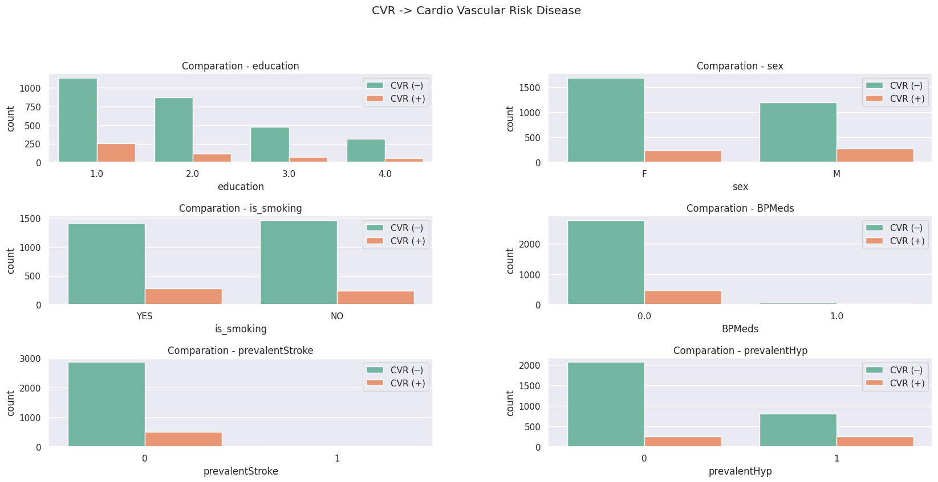

Slide 20
Conclusions of EDA
Now, we can conclude from pie chart that,
(1) There are 85% of people are actually not at risk of Cardio Vascular Risk.
(2) There are only 3% of people who are under BP medication.
(3) There are only 1% of people who had stroke previously.
(4) There are 32% of people who are having Hyper Tension.
(5) There are 97% of the people who are non diabetic.
(6) There are 11%(least) of the people are having highest level education and 42%(highest) of the people are having basic education level.

Slide 21
Conclusions of EDA:
We can conclude from here that,
(1) The people whoever already under the HyperTension, are at more risk of CVR
(2) But its not the same in case of people who were under the attack of stroke once before. The people who never got the stroke are at high risk of CVR.
(3) Whether people smoke or not smoke, they are at risk of CVR.
(4) Its shocking to see that the people who never got any medication barely comes under the risk of CVR. The people who are under BP medications are at high risk of CVR.
(5) When we compare males and females, males are at more risk of CVR.
(6) We can clearly see that, the people who had only basic education i.e., education 1 are at more risk of CVR. And its gradually decreasing with increase in education. It might be because that the people wo are educated are taking much precaustions to avoid CVR.

Slide 22
Conclusions of EDA
We tried plotting all numerical varables with the dependent variables. From here we can conclude that,
(1) The major people who are having Cardio Vasclar Risk(CVR) are at the age of 50-70.
(2) The cholestrol level of people is same for both kind of people who are at risk of CVR and not at risk of CVR. Instead fewer people who are not at risk of CVR are having high Cholestrol level.
(3) If we consider sysBP and diaBP together into consideration, then most of the people are having normal BP. So its hard to conclude to here about the CVR.
(4) Even though many people are having normal range of BMI, but the people whoevever are having high BMI, they are at risk of CVR.
(5) Many people are having normal heartrate range, so its not appropriate to come into conclusion about the CVR at this stage.
(6) In glucose level, we can see some outliers in both kind of people(whoa are at risk and not at risk). But the people who got high glucose level are coming into the category of CVR. So we can conclude that its even one of the factor which may contribute to CVR.

Slide 23
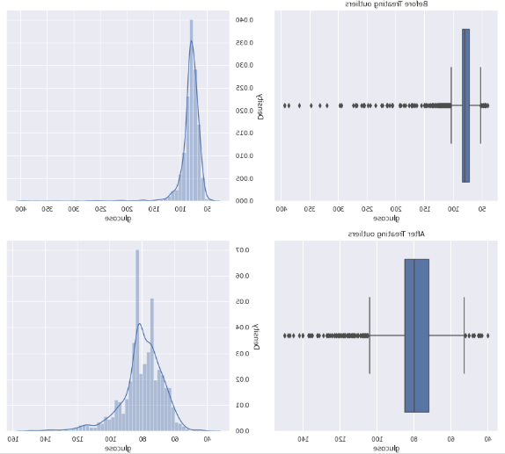
Treatment of Missing Values and Outliers
Treatment of missing values:
There are 6 columns with missing
values.
All the missing values are treated with mean and mode except the ‘glucose’ column.
In glucose column, there are 9% of missing values. So we try dealing with this column from KNN imputation.
Treatment of Outliers :
Outliers treatment in this data set is treated by z score.

Slide 24
Feature Engineering
Feature engineering is the process of selecting, manipulating, and transforming raw data into features that can be used in supervised learning.
Feature Engineering consists of various process :
Feature Creation (2) Transformation (3) Feature Selection
Feature Creation: Creating features involves creating new variables which will be
most helpful for our model.
Transformations: Feature transformation is simply a function that transforms features from one representation to another(Normal distribution). We have used
Box-cox and log transformation to convert columns to Normal distribution.
(1) Feature Selection: Feature extraction is the process of extracting features from a data set to identify useful information. We have used f-regression to do the feature selection.

Slide 25
Feature Engineering
After the process of feature creation, feature transformation and feature selection, we use the one hot encoding to encode all categorical variables.
Later we carry out the standardization technique of minmax scaler to normalize the data.
Now we are all set with the dataset, so at last we check the multicollinearity of the columns. We keep only those columns which are having less or no correlation.

Slide 26
Building model
Before building the models, we perform the train test split. We have taken 70% of the data as train data and 30% of the data as test data.
There are many classification models available in supervised machine learning. The
models which we have used are,
Logistic regression
Decision Tree
Random Forest
K – nearest neighbor
Naïve Baye’s
Adaboost
Support Vector Machine (SVM)

Slide 27
Classification Models
Logistic regression : Logistic regression is a process of modeling the probability of a
discrete outcome given an input variable.
Decision Tree : A decision tree is a mechanical way to make a decision by dividing the inputs into smaller decisions. The tree is divided into decision nodes and leafs. It is based on the concept of entropy.
Random Forest : Random forests or random decision forests are an ensemble learning method for classification, regression and other tasks that operates by constructing a multitude of decision tree at training time.
K – nearest neighbor : K-NN algorithm stores all the available data and classifies a
new data point based on the similarity. This means when new data appears then it can be easily classified into a well suite category by using K- NN algorithm.

Slide 28
Classification Models
5. Naïve Bayes classifiers : Naïve Bayes classifiers are a family of simple “probabilistic clasifiers” based on applying Bayes theorem with strong independence assumptions between the features.
6. Adaboost classifiers : An AdaBoost classifier is a meta-estimator that begins by fitting a classifier on the original dataset and then fits additional copies of the classifier on the same dataset but where the weights of incorrectly classified instances are adjusted such that subsequent classifiers focus more on difficult cases.
7.Support Vector Machine (SVM) : “Support Vector Machine” (SVM) is a supervised machine learning algorithm that can be used for both classification or regression challenges. Here we plot each data item as a point in n-dimensional space with the value of each feature being the value of a particular coordinate. Then, we perform classification by finding the hyper-plane that differentiates the two classes very well.

Slide 29
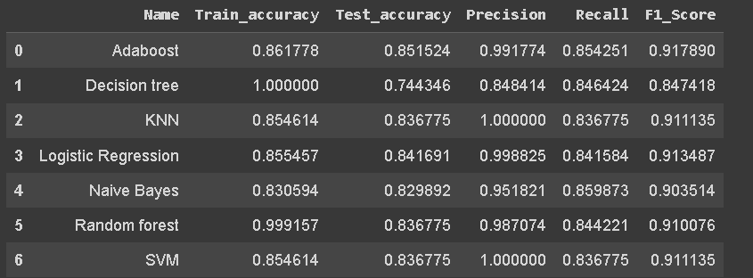
Evaluation Metric
Here we are getting a view of all scores of evaluation metric that is train and test accuracy, Precision, Recall and F1 score.
From here we can conclude that,
(1) precision is always more. Its because we have very few amount of class '1' in the dependent variable. So its hard for the model to learn from the data to predict the target variable as '1'. So we try not to consider the value of precision into consideration.

Slide 30
Evaluation Metric
(2) If we have a look into f1 score, its the same in all the models except decision tree, so we can not consider this to evaluate our model performance in here.
3) So lets just consider, accuracy and recall of these models for evaluation.
(4) First lets just consider recall, the more its near to 1, the more the performance of the model. We can see high recall in Adaboost, Naive Bayes and Random Forest models.
(5) If we now have a look of these 3 models train and test accuracy, then Random forest is overfitting.
(6) So from here, we can conclude that Naive Bayes and Adaboost is performing well.

Slide 31
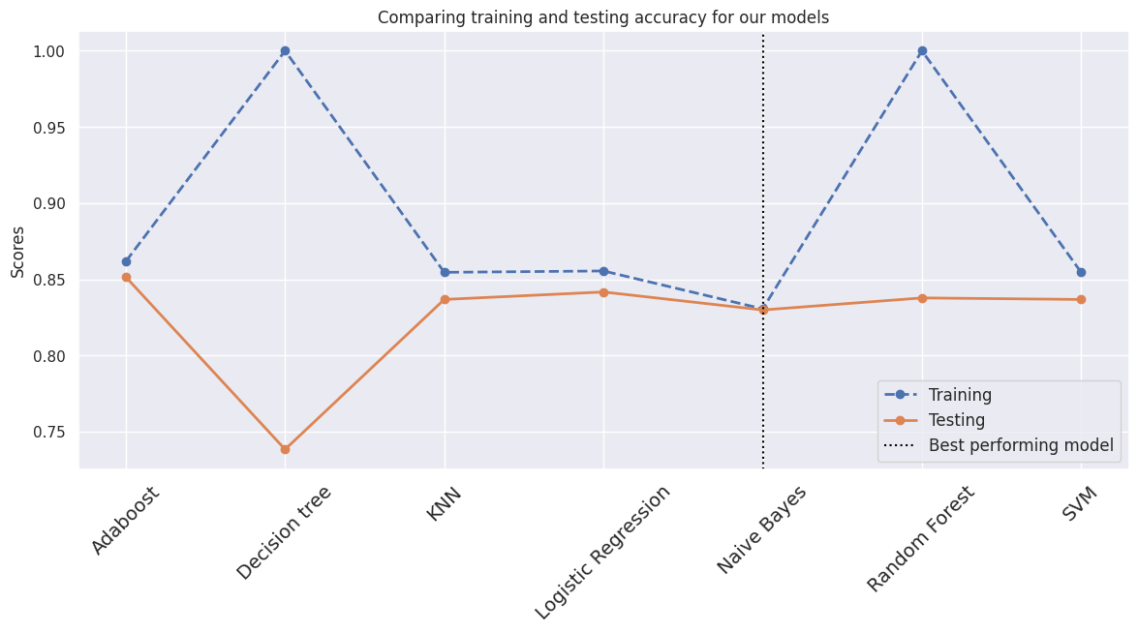
We already had concluded that adaboost and naive bayes are performing well

Slide 32

Precision and Recall
Precision is the proportion of relevant results in the list of all returned search results.
Recall is the ratio of the relevant results returned by the search engine to the total number of the relevant results that could have been returned.
In this project we are giving more importance to recall because predicting that the person does not have a disease when he have one can risk that person's life.

Slide 33
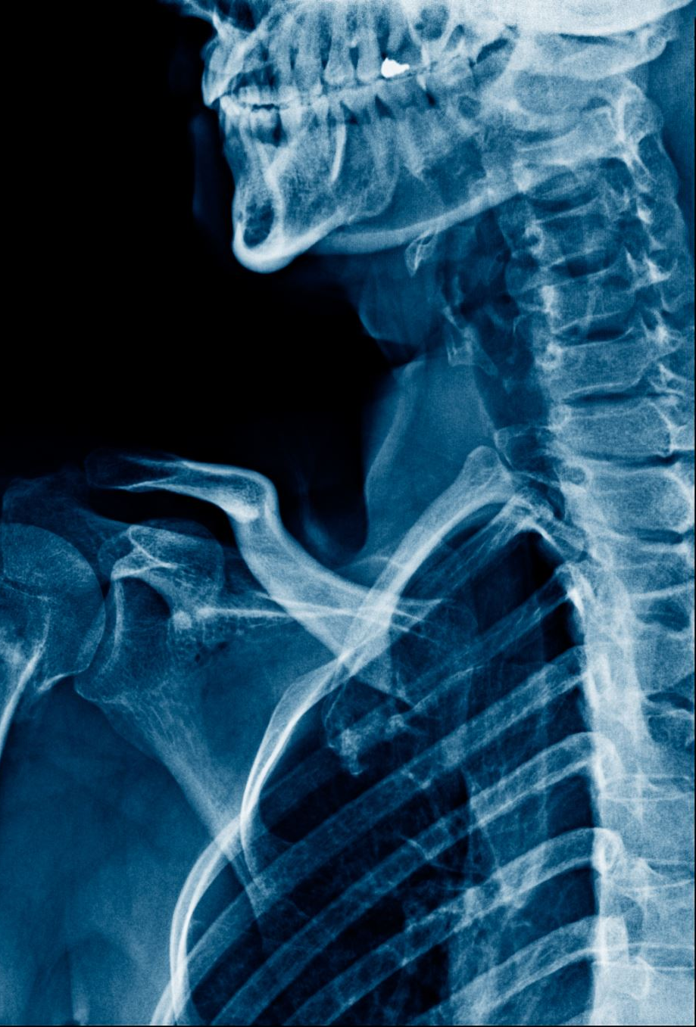
Challenges:
Less amount of data available made it difficult to predict properly.
Missing relevant/Important features in our dataset like Chest pain location, chest pain type, Family history of coronary artery, Exercise, etc.
The dataset was imbalanced and hence we were not able to apply some models properly.

Slide 34
Conclusions
The accuracy of some models were increased after hyper parameter tuning, still Adaboost and naive bayes are the best performing models.
Between those, if we compare Naive Bayes and Adaboost with accuracy and recall, Naive Bayes is the best performance model.

Slide 35
THANK YOU

